Slide 1
Lab2 Ionic
Team : 4-1
MURALI KRISHNA SAI CHUKKA & 09
RUPESH SAI RAM DODDALA & 10
TEJASWI AYYADAPU & 03

Slide 2
Ionic Lab details.
Mashup of at least Two Web Services (refer to the web services from the spreadsheet). One of them should be from the list of knowledge/Machine learning/AI services.
Azure face API as Machine Learning.
YouTube Search API as other service.
Write at least 3-unit test cases related to your application.
Use at least one Cordova plugin related to your project. (QR Code Scanner).
Use YSlow to analyze the performance of all your pages. (This one is removed) .

Slide 3
Demo
Demo

Slide 4
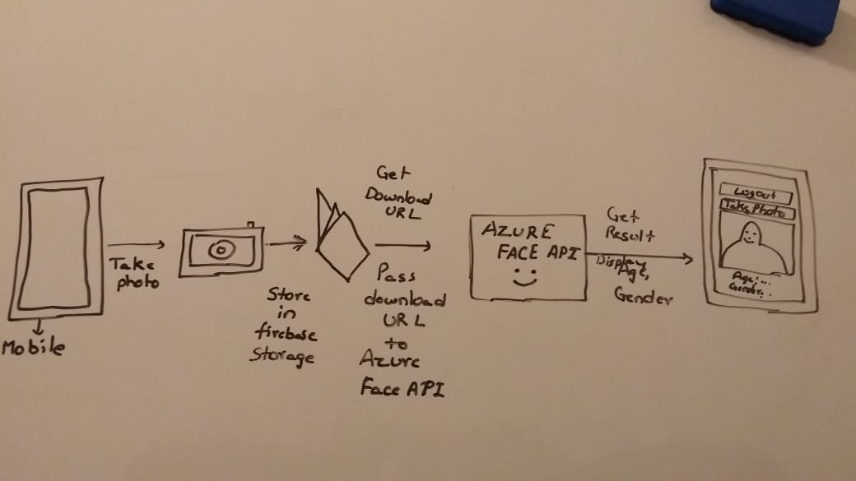
Design Explanation for Azure Face API

Slide 5
Code Explanation
Ionic Code Explanation.

Slide 6
Test case execution
Test case execution

